Slide 1
App-Based Valuation Reports of Mobile Assets
PIP2001 Capstone Project
Final Review
Batch Number: CSE-G135
Roll Number | Student Name
20211CSE0413 | Sushma M Maddin
20211CSE0421 | Sinchana A U
20211CSE0437 | K H Srujan Gowda
20211CSE0444 | Chetha Shree R
Under the Supervision of,
Dr. Pajany M
Assistant Professor
School of Computer Science and Engineering
Presidency University
Name of the Program: CSE
Name of the HoD: Dr. Asif Mohammed H.B
Name of the Program Project Coordinator: Mr. Amarnath J.L
Name of the School Project Coordinators: Dr. Sampath A K

Slide 2
Introduction
The proposed mobile-based valuation system revolutionizes asset valuation by automating workflows, and eliminating manual processes and hard copies.
It features on-site photo capture, in-app annotations, real-time data entry, and cost calculations using advanced algorithms like machine learning.
The app generates professional, shareable PDF reports with annotated images and cost breakdowns, enhancing accuracy, efficiency, and transparency.
By promoting eco-friendly practices, it modernizes valuation workflows, empowering inspectors and stakeholders with a reliable, scalable, and user-friendly solution.

Slide 3
Literature Review
1. The Valuation of Mobile Apps" by Roberto Moro Visconti (2019)
2. The State of Automated Valuation Models in the Age of Big Data" by the Mortgage Bankers Association (2019)
3. A Systematic Literature Review on Automated Valuation Models and Strategic Applications in Real Estate" by Audrius Šešplaukis and Saulius Raslanas (2024)
4. Governing the Ascendancy of Automated Valuation Models" by the Brookings Institution (2023)
5. Real Estate and Land Property Automated Valuation Systems" by Geoffrey Caruso (2018)
6. The Future of Automated Real Estate Valuations" (2023)
7. Methods and Tools for Data Analysis and Visualization “by Vinod Kumar Yadav (2024)

Slide 4
Existing method Drawback
Manual Processes: Heavily reliant on manual data entry, leading to errors, inefficiency, and inconsistency.
Time-Consuming: Lengthy inspections and reporting delay decision-making.
Dependency on Paper: Reliance on hard copies results in data loss risks and eco-unfriendly practices.
Lack of Automation: No advanced algorithms for accurate cost estimation or dynamic updates.
Limited Accessibility: Real-time data sharing and collaboration are difficult, hindering efficiency.

Slide 5
Proposed Method
The "App-Based Valuation Reports of Mobile Assets" system uses a robust technology stack for scalability, efficiency, and user-friendliness.
The backend leverages Flask for RESTful APIs, Pickle for managing machine learning models, and Pandas for data analysis.
React Native powers the cross-platform frontend, supported by Expo for streamlined development and deployment.
MongoDB serves as the NoSQL database, efficiently storing diverse data like asset details and valuation reports.
Flask APIs bridge backend and frontend, enabling seamless data exchange and responsive user experiences.
This integrated stack ensures reliable, flexible, and scalable automation of valuation reports, catering to evolving digital demands and diverse user needs.

Slide 6
Objectives
1 Automate the Inspection Process
Streamlines data collection, photo uploads, and valuation generation through real-time, app-based automation, reducing manual effort.
2 Eliminate the Need for Hard Copies
Replaces paper-based reports with shareable, secure digital formats, supporting eco-friendly and cost-effective practices.
3 Enhance Data Accuracy and Reliability
Utilizes advanced algorithms and real-time data processing to minimize errors and ensure consistent, precise valuations.
4 Improve Workflow and Accessibility
Simplifies operations with intuitive design, seamless data access, and cross- platform compatibility for enhanced user experience.

Slide 7
Methodology/Modules
1. Technology Stack
Backend: Flask (Python-based, for API development and server-side logic).
Data Handling: Pickle (for serializing objects) and Pandas (for data analysis).
Frontend: React Native (for cross-platform mobile development) and Expo (for testing, debugging, and deployment).
Database: MongoDB (NoSQL, flexible document-based storage).
API Integration: Facilitated via Flask APIs to ensure communication between frontend and backend.
2. Requirements Analysis
Focus on automating valuation report generation (eliminating hard copies and manual processes).
Key functionality includes intuitive data entry forms, image uploads, and real-time data entry tools.
Data security, storage, and easy retrieval of historical reports are crucial.
Stakeholders include appraisers, clients, and management teams.

Slide 8
Methodology/Modules
3. System Architecture Design
Frontend: React Native ensures a consistent user experience across platforms (iOS and Android).
Backend: Flask APIs handle server-side logic and report generation.
Database: MongoDB’s document-based structure handles both structured and unstructured data.
API Layer: Ensures efficient data exchange between frontend and backend.
4. Database Design
MongoDB collections:
User Collection: Manages appraisers, clients, and roles.
Asset Collection: Stores asset details, photographs, and metadata.
Valuation Reports Collection: Stores generated reports, linking them to asset data.
Inspection Data Collection: Captures details during on-site inspections (e.g., geolocation, timestamps).

Slide 9
Methodology/Modules
5. UI/UX Design
Focus on intuitive, user-friendly interfaces with clear forms and a responsive layout.
Professional design with a cohesive color scheme (white and blue).
Interactive elements such as a report viewer, easy-to-use image upload tools, and task management features.
Prototypes and wireframes undergo rigorous testing with stakeholders for continuous improvement.
6. Implementation
Frontend: Developed using React Native and Expo, ensuring smooth cross-platform functionality.
Backend: Flask APIs handle the core functionalities (CRUD operations, data processing, and report generation).
The system is designed to streamline the valuation process and deliver an efficient and seamless experience for users.

Slide 10
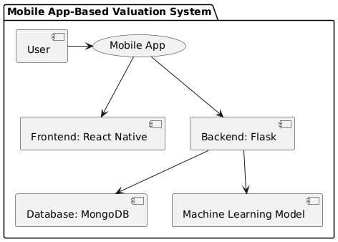
Architecture

Slide 11
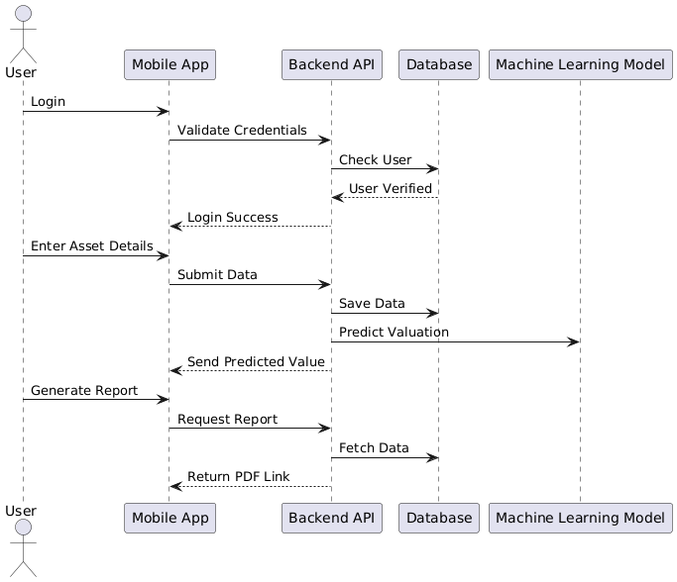
Sequence Diagram

Slide 12
Hardware/software components
Hardware Requirements:
Computer/Laptop: 8 GB RAM, Multi-core processor (Intel i5/Ryzen 5 or higher)
Storage: 256 GB SSD
Smartphone (for testing) - Android or iOS
Software Requirements:
Frontend: React Native, Expo
Backend: Flask, Pandas, Pickle
Database: SQLite or MongoDB

Slide 13
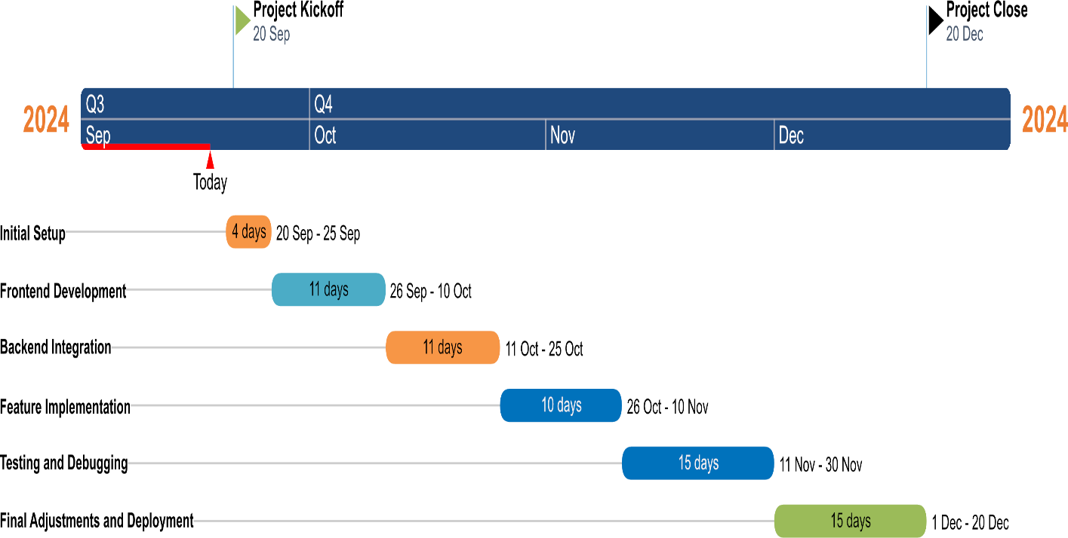
Timeline of Project

Slide 14
Expected Outcomes
1 End-to-End Automation: Streamlining the entire workflow from start to finish through automation to improve efficiency and reduce manual intervention.
2 Paperless Workflow: Transitioning from physical paperwork to digital processes, eliminating the need for paper-based documentation.
3 Real-Time Data Collection and Collaboration: Capturing data instantly and allowing multiple users to collaborate on it in real time, enhancing decision-making.
4 Enhanced Accuracy and Security: Ensuring higher precision in data handling and improving security through encryption and access control mechanisms.

Slide 15
Conclusion
The App-Based Valuation Reports of Mobile Assets revolutionizes mobile asset valuation with a fully automated, eco-friendly solution. It replaces manual processes like data entry, photo uploads, and report generation with seamless automation. Powered by Flask, Pandas, Pickle, and MongoDB, the app ensures fast data processing and scalable storage. React Native and Expo deliver a user-friendly interface across devices. Features like real-time data capture, machine learning for accurate valuations, and blockchain for secure records enhance reliability and trust. By eliminating paper-based workflows, the app promotes sustainability, streamlines operations, and sets a new standard for efficiency, accuracy, and environmental responsibility.

Slide 16
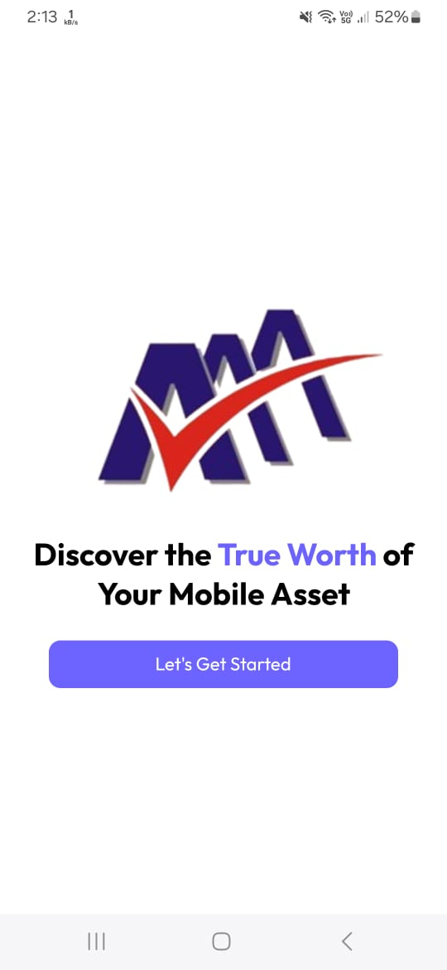
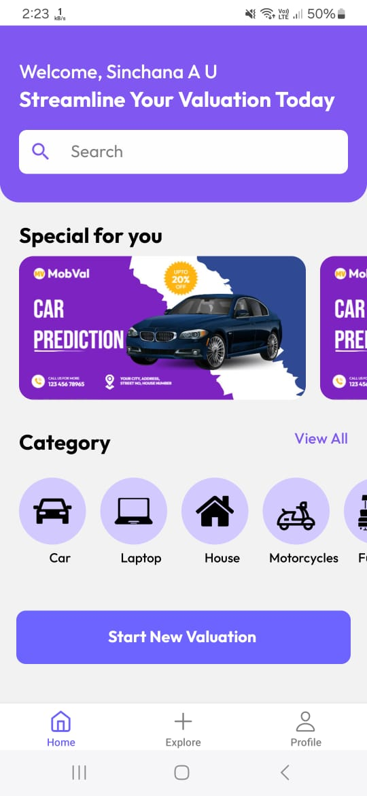
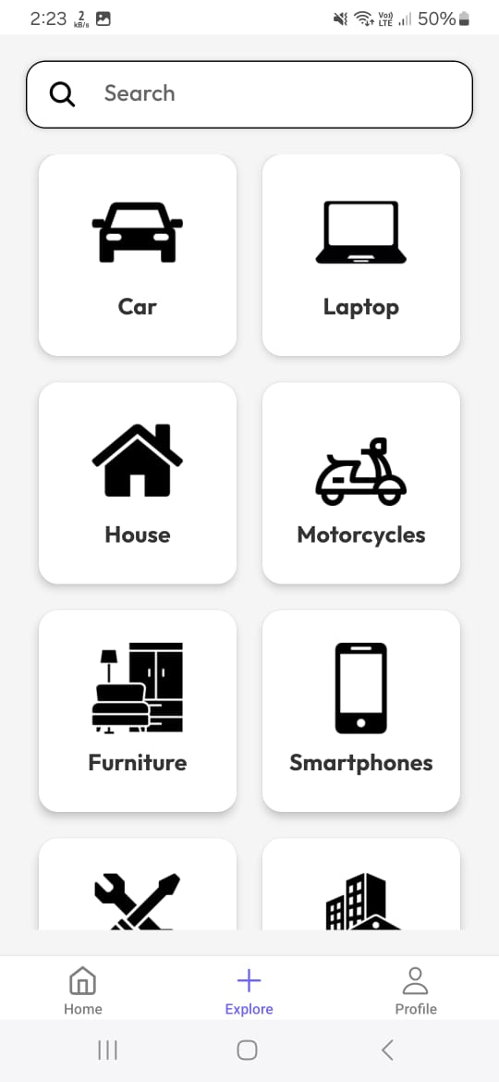
Results:
Home Page
Intro Page
Explore Page

Slide 17
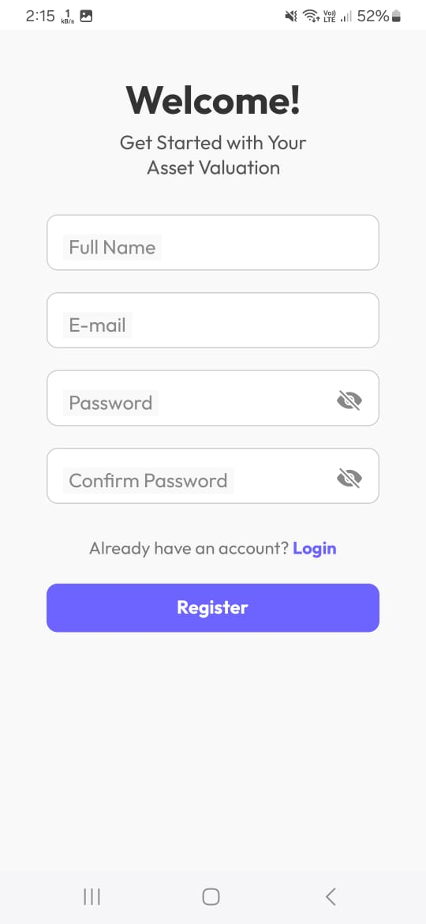
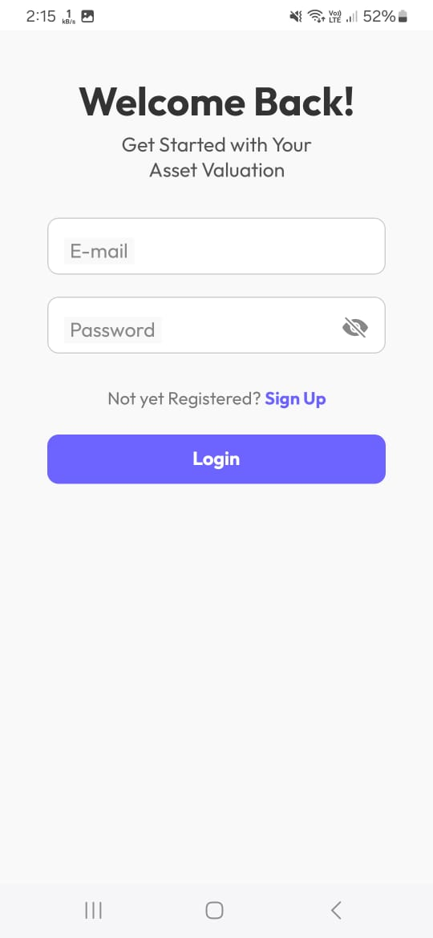
Sign Up Page
Sign In Page

Slide 18
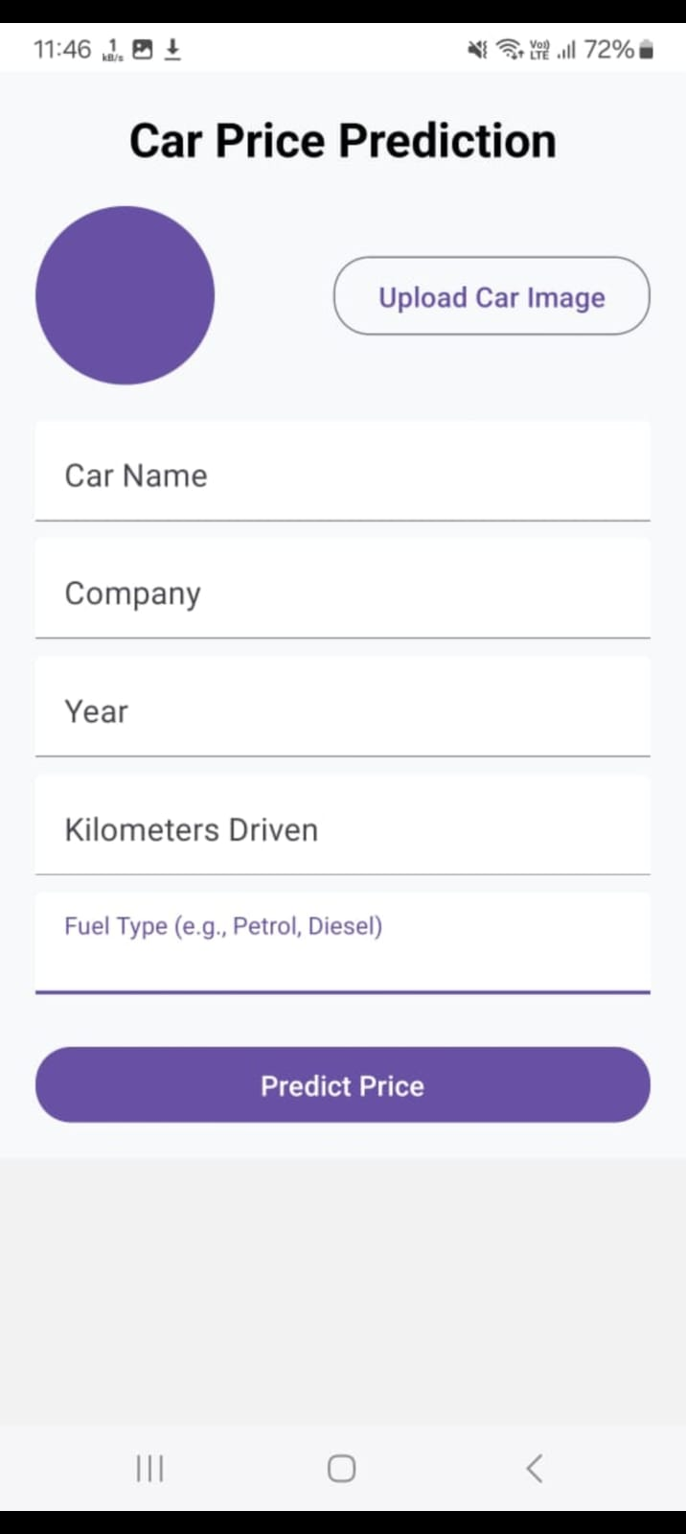
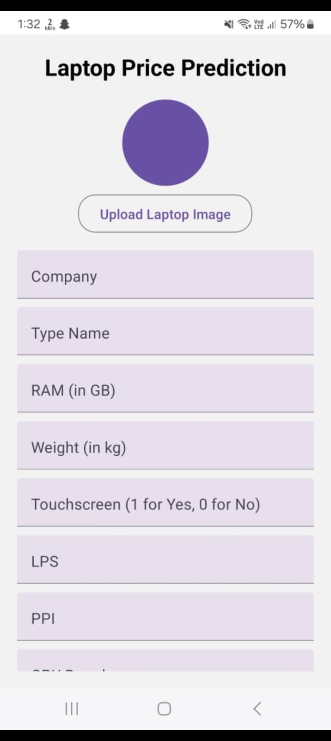
User Interface for Entering Car Details
User Interface for Entering Laptop Details

Slide 19
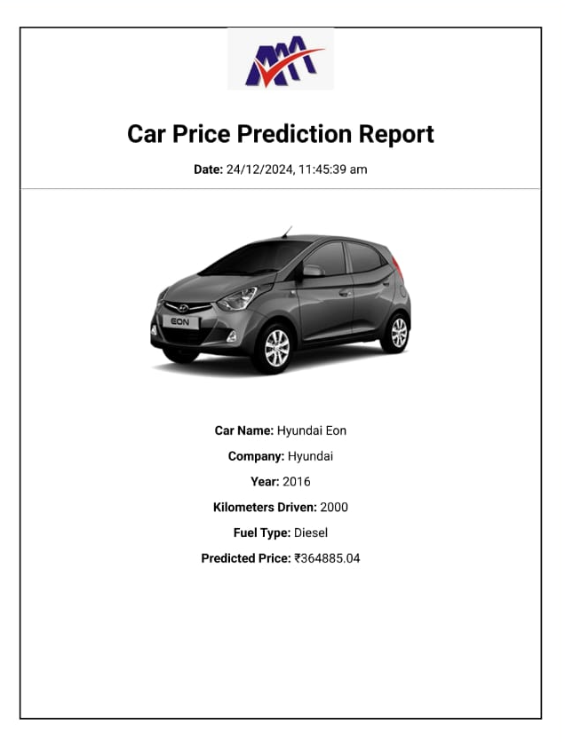
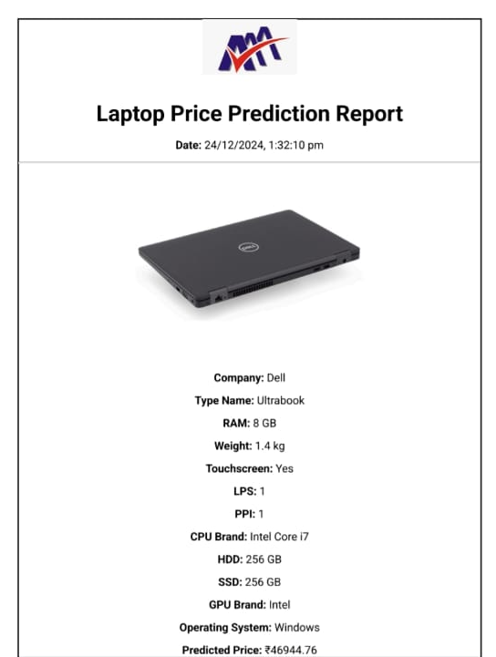
Report generated by the model(Car Details)
Report generated by the model(Laptop Details)

Slide 20
Github Link
https://github.com/Sushma-M-Maddin/App_Based_Valuation_Reports_of_Mobile_Assests-CSE-G135

Slide 21
References
[1]. The Valuation of Mobile Apps (2019) by Roberto Moro Visconti. Paper No. 101, Published on Springer Link.
[2]. The State of Automated Valuation Models in the Age of Big Data (2019) by Mortgage Bankers Association. Paper No. 202, Published on MBA Research Reports.
[3]. A Systematic Literature Review on Automated Valuation Models and Strategic Applications in Real Estate (2024) by Audrius Šešplaukis and Saulius Raslanas. Paper No. 303, Published on ScienceDirect.
[4]. Governing the Ascendancy of Automated Valuation Models (2023) by Brookings Institution. Paper No. 404, Published on Brookings Papers.
[5]. Real Estate and Land Property Automated Valuation Systems (2018) by Geoffrey Caruso. Paper No. 505, Published on Wiley Online Library.

Slide 22
References
[6]. The Future of Automated Real Estate Valuations (2023) by Unknown Authors. Paper No. 606, Published on Real Estate Data Journal.
[7]. Methods and Tools for Data Analysis and Visualization (2024) by Vinod Kumar Yadav. Paper No. 707, Published on Taylor & Francis Online.
[8]. A Deep Dive into Automated Valuation Models: The Pros, Cons and Applications (2023) by Certified Credit. Paper No. 1010, Published on Certified Credit Blog.
[9]. Data Visualization Techniques: Advances and Applications (2024) by Multiple Authors. Paper No. 1111, Published on MDPI Applied Sciences.
[10]. Information Visualization (2023) by Multiple Authors. Paper No. 1212, Published on SAGE Journals

Slide 23

Project work mapping with SDG

Slide 24
Project work mapping with SDG
The App-Based Valuation Reports for Mobile Assets strongly supports the United Nations Sustainable Development Goals (SDGs) by leveraging technology to address global challenges. The app contributes to
SDG 12: Responsible Consumption and Production,
SDG 9: Industry, Innovation, and Infrastructure,
SDG 13: Climate Action, promoting sustainability, efficiency, and innovation in asset valuation.
SDG 17: Partnerships for the Goals by fostering collaboration among stakeholders.

Slide 25
Thank You

